Slide 1




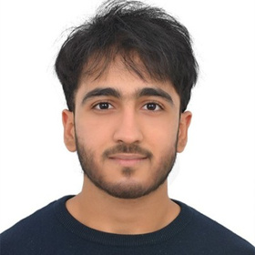
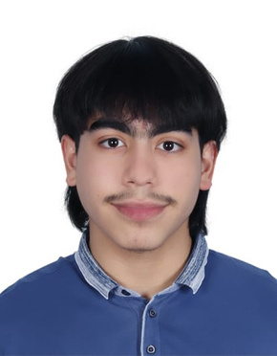


Ahmed Hanif 60301085
Environmental Awareness Workshop
BUSG2201
MS. AMY SENOUSI
01
02
03
04
AHMED HANIF 60301085
GEITH EL-ZAHER
60300365
IBRAHIM ELZINE
60074319
MOHAMMED AL-KAABI
60100771
Project Manager
Marketing Coordinator
Logistics Manager
Stakeholder Relations Manager

Slide 2
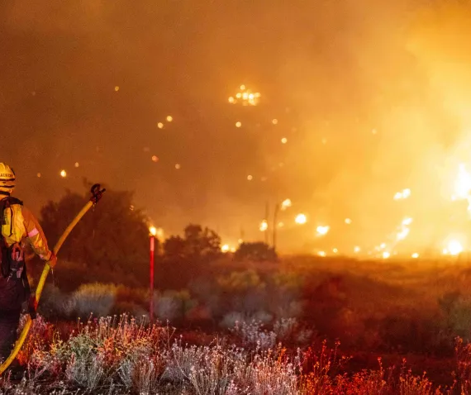
Nature
Ahmed Hanif 60301085
Climate Change News
June 14, 2024
Wildfires are raging in Nepal
Wildfires in Nepal have surged, exacerbated by both climate change and human activities. Mismanagement and changing local interactions with forests have heightened fire risks, causing extensive damage and significant loss of life. Enhanced fire prediction systems and better preparedness could mitigate future wildfires. (Bolakhe, 2024)

Slide 3



Ahmed Hanif 60301085
TODAY’S AGENDA
Team Call
Introduction & Background
Project Charter
Project Schedule & Milestones, and GANTT Chart
Risk Management Plan
Stakeholder and Communication Management Plan
Conclusion

Slide 4
Ahmed Hanif 60301085
INTRODUCTION & BACKGROUND
Event
UDST Environmental Awareness Workshop 2024
Date
September 26 - September 28
Purpose
Addressing global and local environmental challenges such as climate change
Vision
Aligns with Qatar National Vision 2030 and UDST’s Commitment to Local and Global Sustainable development
Tradition
Continuing UDST's history of hosting impactful symposiums
Engagement
Unite students from across Qatar.
Activities
Three Days of Workshops, Team Collaboration, and Solution Pitching
Outcome
Development of innovative solutions, with top three proposals earning further support and funding.
Introduction
Background

Slide 5

Ahmed Hanif 60301085
Project Charter
Scope
Objectives
Assumptions
Constraints
UDST's three-day workshops focus on environmental challenges through lectures, teamwork, and a competition finale. Excludes non-environmental topics, external audiences, outside venues, and political advocacy.
Aim to register 150 students, feature 3 expert speakers, and generate three actionable environmental solutions.
Assumes availability of the Dukhan Auditorium, active student participation, and adequate support from UDST and sponsors.
Limited by a fixed budget of QAR 286,000, staffing restrictions, and the need to complete within the Fall 2024 semester.

Slide 6

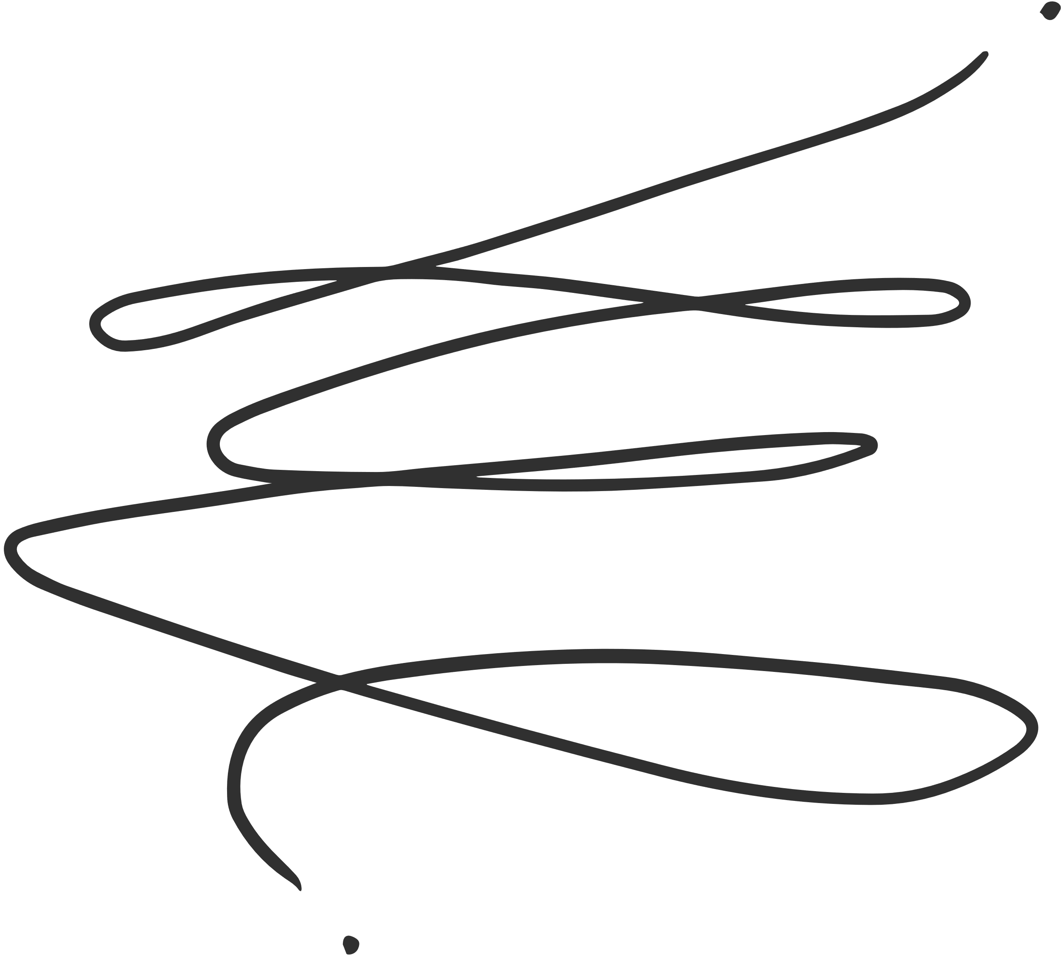
Ahmed Hanif 60301085
PROJECT CHARTER
Key Delieverables
Organising Venue
Booking and Setting venue
Coordinating Speakers
Identifying and Confirming speakers
Managing Participants
Finalizing and Registrating
Finalising Sponsorship
Engaging and Contracting
Organizing Catering
Plan and Manage Company
Monitoring Technical Support
Set Up and Manage Technical Equipment
Technical Troubleshooting
Event Planning
Support Services
Conducting Promotion
Designing and Launching
Administrating Public Relations
Press Release
Media Coverage
Marketing and Communication
Feedback Collection
Develop, Distribute and Analyze Feedback
Reporting
Document Lessons Learned
Prepare post-even report
Official Project Closure
Post Event Activities
Managing Sessions
Conduct Workshops
Manage Session Logistics
Developing Competition
Organising Pitching competition
Managing Judging and Awards
Workshop Execution

Slide 7
Project Timeline
Start
End
Start
Start & d
11 Weeks
19th May 2024
17th October 2024
COMPLETED | IN-PROGRESS | TO BE COMPLETED BY June | TO BE COMPLETED BY AUGUST | TO BE COMPLETED BY September | TO BE COMPLETED BY October
Project Charter Approval (Project Team) | Identifying and Inviting Speakers | Identifying and Inviting Speakers | Conducting Promotion | Developing Competition | Reporting
Booking Venue (Ibrahim) | Conducting Promotion | Finalize Sponsorship Details | Finalize Participants | Organizing Catering | Project Closure
Finalize Sponsorship Details
PROJECT CHARTER
Project Schedule and Key Milestones
Mohammed Al-Kaabi
60100771

Slide 8
Mohammed Al-Kaabi
60100771
Task
May 19 - May 30
Jun 2 - Jun 13
Jun 23 - Jul 4
Aug 25 - Sep 5
Sep 8 - Sep 19
Sep 22- Oct 3
Oct 6 - Oct 17
Book Venue
Ibrahim Alzini - Logistics Manager
Identify and Invite Speakers
Mohmmad Al Kabi - Stakeholder Relations
Finalize Participants
Mohmmad Al Kabi - Stakeholder Relations
Identify and Engage Sponsors
Ahmed Hanif - Project Manager
Finalize Sponsorship Deals
Ahmed Hanif - Project Manager
Design Marketing Materials
Geith El-Zaher - Marketing Coordinator
Launch Marketing Campaign
Geith El-Zaher - Marketing Coordinator
Gantt Chart
Plan Workshops
Ibrahim Alzini - Logistics Manager
Set up Technical Equipment
Ibrahim Alzini - Logistics Manager
Conduct Workshops
Project Team
Organize Pitching Competition
Ahmed Hanif - Project Manager
Manage Judging and Awards
Ibrahim Alzini - Logistics Manager
Distribute Feedback Forms
Geith El-Zaher - Marketing Coordinator
Prepare Post-Event Report
Ahmed Hanif - Project Manager
Official Project Closure
Ahmed Hanif - Project Manager

Slide 9







Ibrahim ElZine
60074319
Risk Breakdown Schedule
Project Management Risk
Organizational Risk
Resource Availability
Geith El-Zaher
Stakeholder Engagement
Mohammed Al-Kaabi
Schedule Management
Ahmed Hanif
Communication Management
Mohammed Al-Kaabi
Logistics and Vendor Management
Ibrahim Alzini
03
04
External Risk
02
05
Public Perception and Media
Geith El-Zaher
Technical Risk (Positive)
Innovation Risks (Positive)
Ahmed Hanif
01
06
Technical Risk
External Risk (Positive)
Innovation Risks (Negative)
Ahmed Hanif
Stakeholder Engagement (Positive)
Mohammed Al-Kaabi

Slide 10
Ibrahim ElZine
60074319
Risk Name | Response Plan
Innovation Risks (Negative) | Pilot test new methods; seek expert advice during planning.
Public Perception and Media | Develop a proactive PR strategy with regular press releases and social media presence.
Resource Availability | Create a detailed resource management plan; secure early commitments.
Stakeholder Engagement | Regular updates and involvement of stakeholders in planning and feedback.
Stakeholder Engagement (Positive) | Maximize engagement through targeted outreach and showcasing project benefits.
Schedule Management | Monitor project regularly and adjust schedules to manage delays.
Innovation Risks (Positive) | Encourage innovation, provide resources, and recognize contributions.
Communication Management | Implement robust communication protocols; regular updates and clear documentation.
Logistics and Vendor Management | Develop comprehensive logistics planning; regular checks and coordination with vendors.
Health and Safety | Implement safety protocols, arrange for on-site medical staff, and conduct regular safety audits.
Risk Mitigation Strategy

Slide 11
Ibrahim ElZine
60074319
INNOVATION RISK (POSITIVE) | RESOURCE AVAILABILITY, SCHEDULE MANAGEMENT
COMMUNICATION MANAGEMENT, LOGISTIC AND VENDOR MANAGEMENT | INNOVATION RISK, STAKEHOLDER ENGAGEMENT | HEALTH AND SAFETY
 | PUBLIC PERCEPTION AND MEDIA
likely
Moderate
LIKELIHOOD
PROBABILITY IMPACT MATRIX
Unlikely
Moderate
High
Extreme
IMPACT

Slide 12
Geith El-Zaher
60300365
COMMUNICATIONS PLAN
Progress Updates to ensure Alignment with University Goals (Zoom, Email and Bi-Weekly)
UDST Faculty and Administration
Catering (Le Soleil)
Coordination Meetings Monthly to Ensure Event Specifications (Direct Calls and Emails)
Monthly Email Updates and Engagement Opportunities (University Email System)
Interested University Students in Qatar
Research Institutions (QEERI, QU)
Bi-Monthly Collaboration Sessions for Research Integration (Microsoft Teams and Email)
STAKEHOLDERS
Quarterly Expert Insight Sharing and Milestone Reviews (Professional Contacts and Emails)
Enviromental Experts (Andy Acho and Scott Amyx)
Monthly Briefings on Evaluation Criteria and Schedules (Email and Video Calls)
Judges (Mahmoud Al Sulaiti and Abdullah Al Kubaisi)
Event Sponsors and Partners (UDST, Qatar Foundation)
Weekly Planning Updates and Task Management Sessions (Zoom/Teams and Emails)
Monthly Financial and Progress Reports to Sustain Support and Visibility (Email and Formal Presentations)
Project Team

Slide 13

GeitH el-zaher
60300365
Project Stakeholder and Communications Plan
Potential Communication Issues/Challenges
Mismatched Update Frequencies
Information Overload
Faculty and Administration may require more frequent updates during critical decision-making periods than the monthly updates planned.
Sponsors might need immediate communication regarding any changes that affect their interests, rather than just the scheduled monthly updates.
Project Team could experience information overload with weekly updates, potentially leading to missed or overlooked critical information.

Slide 14






Conclusion
GeitH el-zaher
60300365
Key Takeaways
Call to Action
Global Issues, Local Impact
Integrate Environmental Sustainability
Fostering Innovative Solutions
Amplify the Message
Aligning with UDST's Mission
Collaborate for Change

Slide 15
References
Bolakhe, S. (2024). Wildfires are raging in Nepal — climate change isn’t the only culprit. Nature. https://doi.org/10.1038/d41586-024-01758-2
Government Communications Office. (2024, May 2). Qatar National Vision 2030 - Government Communications Office. https://www.gco.gov.qa/en/about-qatar/national-vision2030/
University of Doha for Science and Technology. (n.d.). Vision and mission. Retrieved June 21, 2024, from https://www.udst.edu.qa/about-udst/udst-glance/vision-and-mission
University of Doha for Science and Technology. (n.d.). UNIT 1 - Introduction to Project Management - Instructor Presentation. Retrieved from https://d2l.udst.edu.qa/d2l/le/content/112332/Home
University of Doha for Science and Technology. (n.d.). UNIT 2 - The Environment in which a project resides - Instructor Presentation. Retrieved from https://d2l.udst.edu.qa/d2l/le/content/112332/Home
University of Doha for Science and Technology. (n.d.). UNIT 3 - Project Integration Management - Instructor Presentation. Retrieved from https://d2l.udst.edu.qa/d2l/le/content/112332/Home
University of Doha for Science and Technology. (n.d.). UNIT 4-1 - Project Scope Management - Instructor Presentation. Retrieved from https://d2l.udst.edu.qa/d2l/le/content/112332/Home
University of Doha for Science and Technology. (n.d.). UNIT 4-2 - Project Scope Management - Instructor Presentation. Retrieved from https://d2l.udst.edu.qa/d2l/le/content/112332/Home
University of Doha for Science and Technology. (n.d.). UNIT 5 - Project Schedule Management - Instructor Presentation. Retrieved from https://d2l.udst.edu.qa/d2l/le/content/112332/Home
University of Doha for Science and Technology. (n.d.). UNIT 7 - Project Stakeholder and Communication Management - Instructor Presentation. Retrieved from https://d2l.udst.edu.qa/d2l/le/content/112332/Home
University of Doha for Science and Technology. (n.d.). UNIT 8 - Project Risk Management - Instructor Presentation. Retrieved from https://d2l.udst.edu.qa/d2l/le/content/112332/Home

Slide 16
The End
Thank You So Much For Listening.
We will be Very Happy to Answer Any Questions
BUSG2201
MS. AMY SENOUSI

